Slide 1

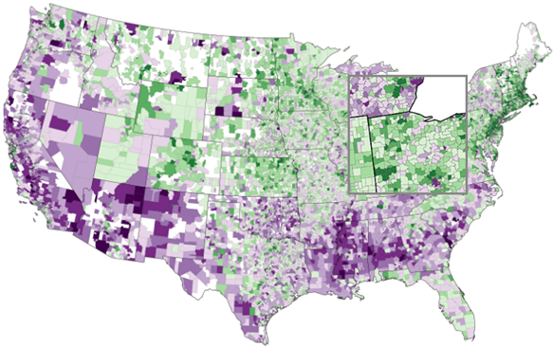
Big Data as Public Good:
An Example from Education
Andrew Ho, Harvard Graduate School of Education
with Sean Reardon, Erin Fahle, Demetra Kalogrides (Stanford), Ben Shear (Colorado),
Katherine Castellano (ETS), and Ken Shores (University of Pennsylvania)
Delaware Data Science Symposium
University of Delaware – May 11, 2017 – Newark, Delaware

Slide 2

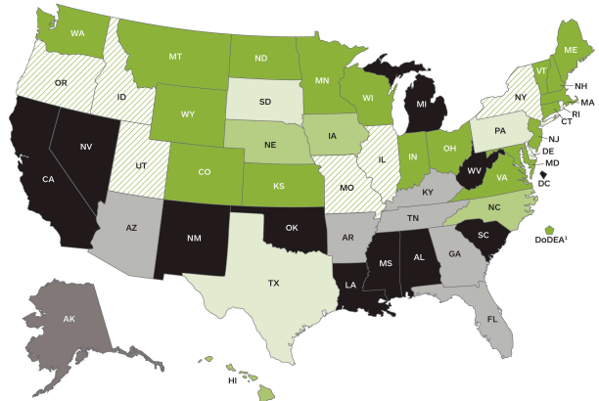

State Achievement Variation (NAEP), 2013 Math
$$n≈400K$$
Source: NCES (2014)

Slide 3
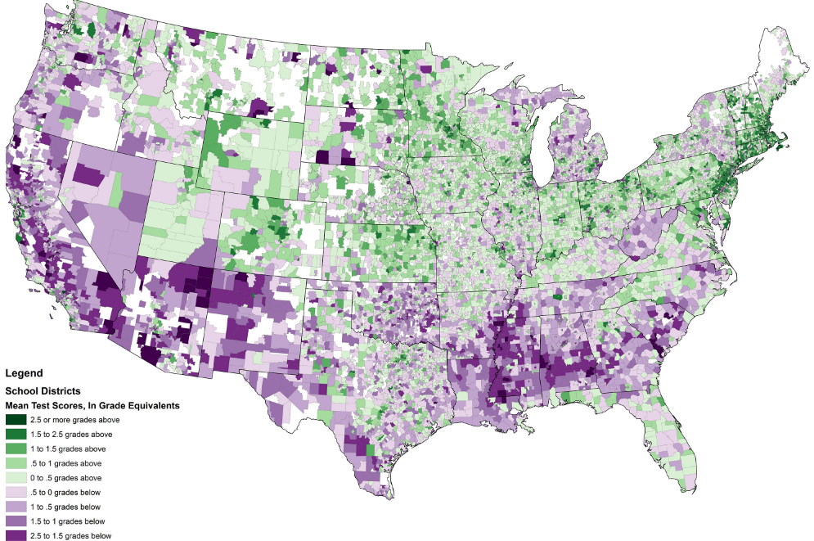

District Achievement Variation (SEDA), 2009-2013
$$n≈300M$$
Source: seda.stanford.edu

Slide 4
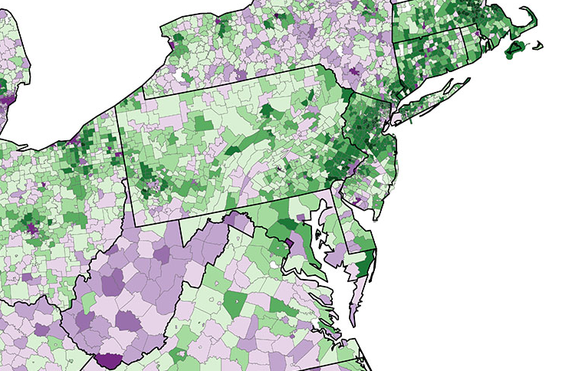
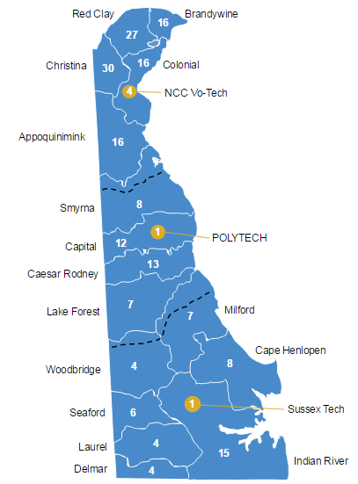
Local District Achievement Variation (SEDA), 2009-2013
Source: seda.stanford.edu
$$n≈300M$$

Slide 5
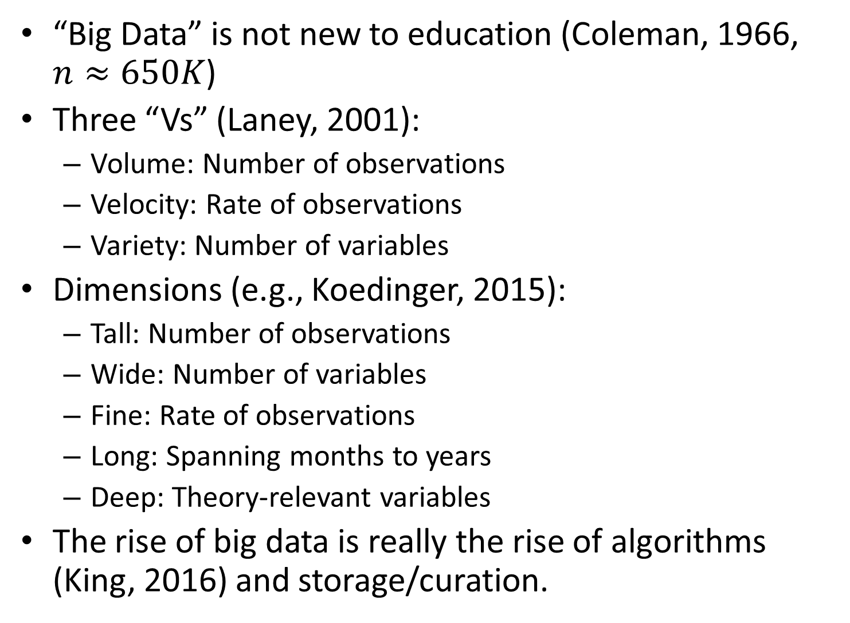
Big Data Taxonomies
“Big Data” is not new to education (Coleman, 1966, $n≈650K$)
Three “Vs” (Laney, 2001):
  Volume: Number of observations
  Velocity: Rate of observations
  Variety: Number of variables
Dimensions (e.g., Koedinger, 2015):
  Tall: Number of observations
  Wide: Number of variables
  Fine: Rate of observations
  Long: Spanning months to years
  Deep: Theory-relevant variables
The rise of big data is really the rise of algorithms (King, 2016) and storage/curation.

Slide 6
Big Data Taxonomies (Ho, 2017): http://bit.ly/adhbigdata
For me, the key distinctions for Big Data are less its apparent features than its genesis and purpose.
Genesis:
Before “data collection” and “data mining” comes “data creation” (Ho, 2015). Do we understand the processes that generated the data?
  Rarely designed with research in mind. Usually “exhaust” or “residue” from program administration or server logs.
  Most of the key work is avoiding variable reification (the naming fallacy), e.g., “proficiency.”
Purpose:
Who has access to the data?
For what purposes?
  Prediction or intervention? Administering educational programs? Informing business strategy? Academic research?

Slide 7
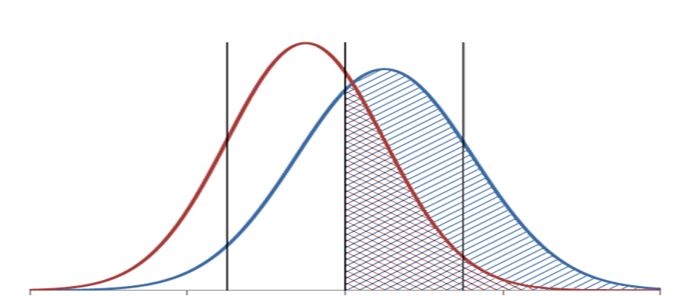
The relentless development of METHODS
Question: If 75% of high-income kids are “proficient,” and 30% of low-income kids are “proficient,” then what is their difference in average test scores?
We developed “ordered probit models” (Ho, 2009; Ho & Reardon, 2012; Reardon, Shear, Castellano, & Ho, 2016) to estimate means and standard deviations from proficiency data.

Slide 8
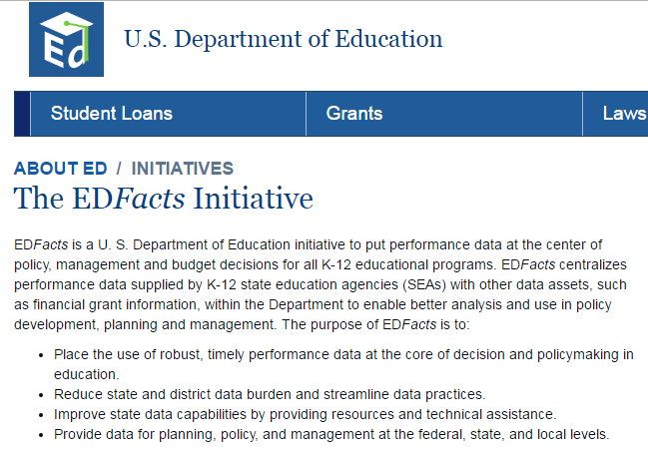
The relentless pursuit (and cleaning!) of DATA
It turns out there’s a lot of proficiency data.
U.S. Department of Education
  Ross Santy
  Michael Hawes
  Marilyn Seastrom
NWEA
  Yeow Meng Thum

Slide 9
seda.stanford.edu: The marriage of METHODS and DATA
Determine where each school district’s average ranks in the statewide distribution (in a given grade-year-subject)
Locate districts where they rank within their state NAEP score distributions, following where states fall in the national test score distribution.
Standardize scores to represent approximate “grade equivalents” of national NAEP distribution.
Average within districts (across 6 grades, 5 years, 2 subjects).
Link to other available data on schools/districts/ communities.

Slide 10
Local District Achievement Variation (SEDA), 2009-2013
Source: seda.stanford.edu
$$n≈300M$$

Slide 11

Local District Achievement Variation (SEDA), 2009-2013
$$n≈240M;N≈12K$$
Source: seda.stanford.edu

Slide 12
Nationwide District Achievement Variation, 2009-2013

Slide 13
Nationwide District Achievement Variation, 2009-2013

Slide 14
Nationwide District Achievement Variation, 2009-2013

Slide 15
Nationwide District Progress Variation, 2009-2013

Slide 16
Nationwide District Progress Variation, 2009-2013

Slide 17
Nationwide District Progress Variation, 2009-2013

Slide 18
Caveats and cautions in using our big data
These estimates are not simply “school quality.” Many factors affect student test scores, including children’s home, neighborhood, early childhood, parental, nutritional, pre-school, after-school, and K-12 schooling experiences
Our estimates are measures of performance. They are affected by what students have been taught and have learned and how motivated they are to perform on standardized tests.
Test performance is not the sole educational outcome we care about; but it is a reasonable proxy for the extent of opportunity and achievement.
Our achievement estimates are not exact and should not be used to make fine distinctions among school districts in different states.

Slide 19
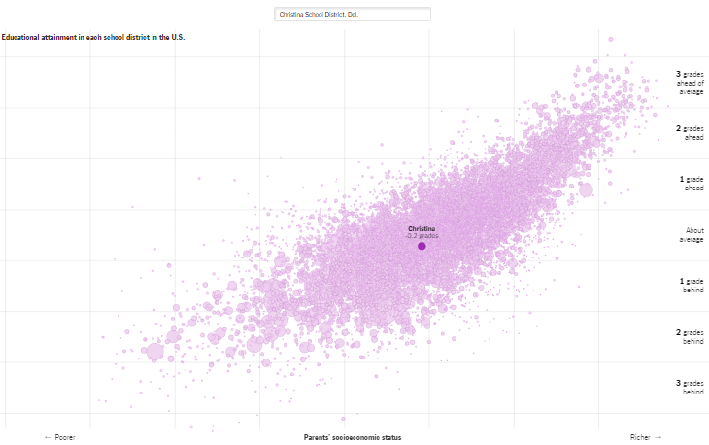
Exploratory Data Analysis (NYTimes Upshot)

Slide 20
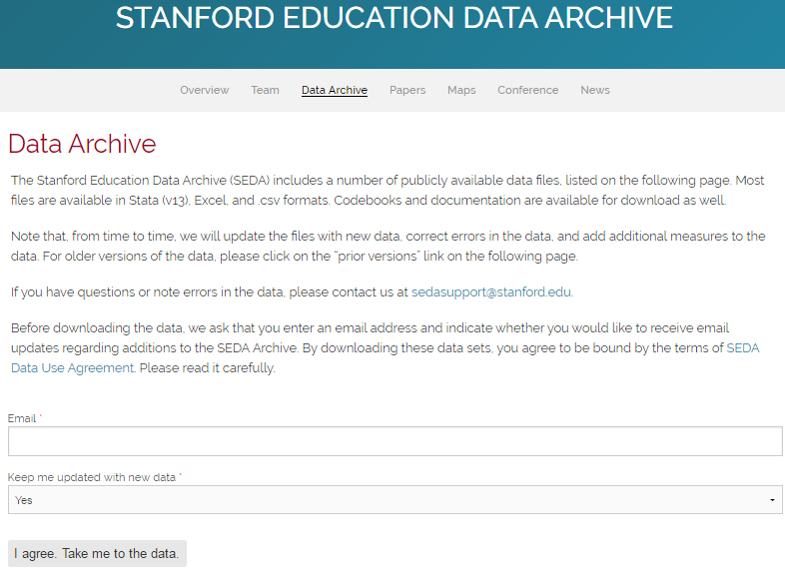
Use SEDA for research. Use SEDA for your teaching.

Slide 21

Upcoming grant opportunity
(TBA: summer/fall 2017)

Slide 22
Some closing encouragements and questions for your day
Make your data available (publicly, if possible) and your analyses transparent and replicable.
  To the extent you can while ensuring privacy protection.
Contribute to and invest in the local research infrastructure.
  e.g., secure computing environments, physical and remote. Data warehouses. Institutional research.
Share and encourage sharing course assignments and projects across data science courses, e.g., Gary King’s “Publication, Publication,” or SEDA.
What will “success” look like in 3 years? 10 years? What impact should a data science initiative have on research, teaching, and the public good?

